Slide 1
Group 5 | Event Planner
Anirudh Bagde, Rupin Bhalla, Catherine Ta
Notes:
Catherine

Slide 2
Project Description
Easy interaction between university clubs and students
GobblerConnect — web accessible, but boring, and not very well updated
Organizations hand out flyers, students throw them away
Improved Event Planner application for organizations and students
Clubs can:
Update information
Create and edit events
Students can:
View the organization/event details
Follow events or certain clubs
Receive notifications on any update
Implemented only back end portion with a very simple GUI Interface
Notes:
Catherine ---- ALSO, FURTHERMORE, IN ADDITION, LIKEWISE, ADDITIONALLY, IN TURN
Emphasis on easy interaction/connection between university clubs and students
On the Drillfield or in front of dining halls, organizations hand out flyers, students throw them away
Clubs use Facebook and email to communicate and relay information to their attendees, but not always on one uniform application
GobblerConnect
NOT GobblerConnect mobile application because wanted to support more than one university
By creating our own application, we can also add our own features such as following organizations/events, and notifications
Integrating with the university’s backend for GobberConnect would be difficult, therefore we found it easier to create our own backend and API
Improved Event Planner application for organizations and students
Clubs can:
Update information
Create and edit events
Students can:
View the organization/event details
Follow events or certain clubs
Receive notifications on any update
Implemented only back end portion with a very simple GUI Interface in order to make testing easier

Slide 3
Project Requirements
Improve on existing systems (eg. GobblerConnect)
Features such as mobile support and quick updates
Easy to use by both organizers and attendees
Accessible to both web and mobile clients
Including push notifications and real-time updates
Simple event discovery for both students and visitors
Users can follow organizations and events to receive updates
University can have admin access if necessary
Measures to prevent spam
Notes:
Catherine ---- ALSO, FURTHERMORE, IN ADDITION, LIKEWISE, ADDITIONALLY, IN TURN
Improve on existing systems (as mentioned before, GobblerConnect)
Features such as mobile support, quick updates, and following
Easy to use by both organizers and attendees
One application for both users
Low barrier of entry: students will want to use it because it doesn’t take much effort to use
Students also use their phones due to ease of access since it’s right in the palm of your hand or in your pocket
Accessible to both web and mobile clients
Including push notifications and real-time updates
Users can follow organizations and events to receive updates and reminders about events when the date of the event approaches
Simple event discovery for both students and visitors
Searching, categories, possibly filtering based on interests
University can have admin access if necessary to ensure that organizations are affiliated with the university, and also to revoke organizations
Measures to prevent spam
Every user admin of max one org to prevent creation of too many organizations
Eventually connect the application to the university, again, to prevent creation of too many organizations (not affiliated with the organization)

Slide 4
Use Cases
Query for Events
Search for University
Filter University Events by Category
Query Universities by Location
User Account Creation
User Login
User Logout
Query Information for Profile
User Follows Organization
User Follows Event
Create Organization
Add User as Organization Admin
Revoke Access for Organization Admin
Create Event
Update Event Description
Delete Event
Notes:
Rupin
The use cases 1-4 cover event discovery,
1,3 = Searching for Events
2,4 = Seaching for univerisiteis
5,6, 7, 8 = User Account Operation
9, 10 = User following things
11, 12, 13 = Organization administration details
14, 15, 16 = Event details

Slide 5
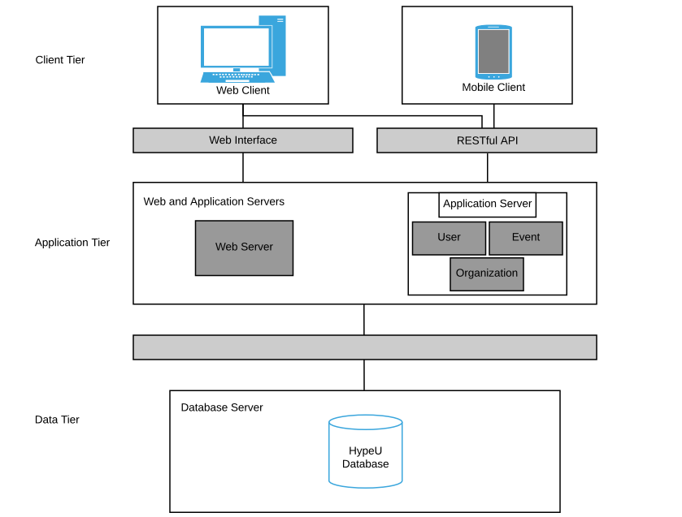
High Level Design: Architecture
Notes:
Rupin
The model follows the three layer architecture as you can see above. The 3 layer architecture consists of the client tier, the application tier, and the data tier.
In our architecture, the client tier is represented by the users that connect to the service. In our client tier we have both a web client and a mobile client. They will be able to connect through a website or a mobile app.
As you can see the application tier is composed of 2 different parts. The first part is the web server will is connected to the web client, and the application server which is used for mobile clients. We broke it up in this manner because both the clients will have different needs and functionality, so we thought it would be best to break them up. The application server exposes an API for interacting with the object to the database.
The last part of our 3 tier architecture is the data tier. The data tier has a database which stores our users, events, and organizations.
The model follows the three layer architecture, which consists of the client tier, the application tier, and the data tier. In our architecture, the client tier is represented by the users that connect to the service. The clients can connect to the application through various interfaces, including a website or a mobile app. The application tier is composed of two parts, the web server and the application server. The web server would be for serving the web clients. Meanwhile, all the clients will be connecting to the service via the application server. This server exposes an API for interacting the object represented by the database. Finally, the application server connects to the database which stores our users, events, and organizations.

Slide 6
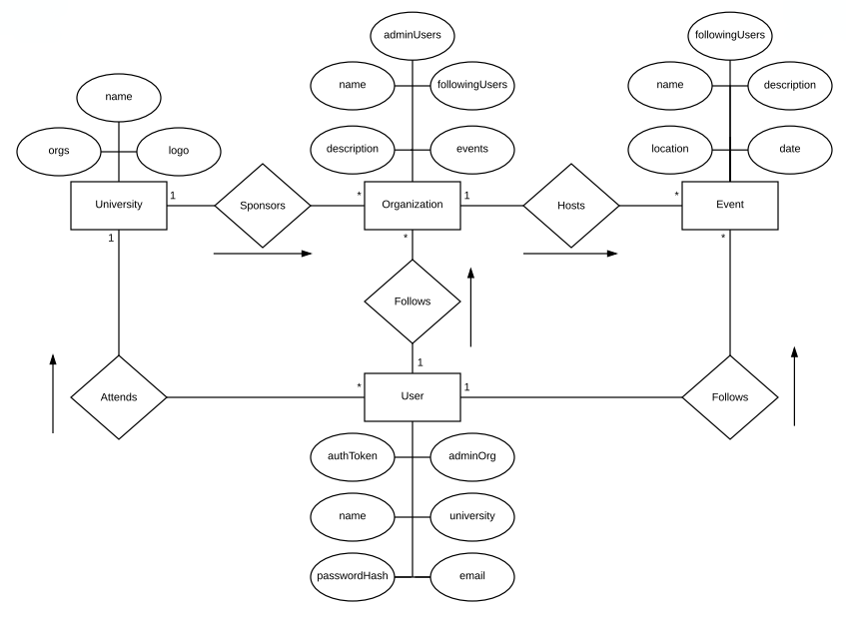
Detailed Design: Entity-Relationship Diagram
*
*
Notes:
Rupin
This is our Entity-Relationship Diagram which consists of the tables of our database. Along with the tables, it also shows the structure of our database. The main essential parts of our database/project are the University, Organization, Event, and User.
Also you can see that the User is the main, centeral part of the application, and as you can see the certain atributes
As you can see the User is connected to the University, Event, and Organization. The User attends the University and the User follows Event. The user has a many to 1 relationship with the University because a user can be part of many universities.
The user also has a many to many relationship with the event. This is because a user can follow many events.
The User has a many to many relationship between an organization because a user can follow many organization.
The University is connected to an organization because it is sponsored by an organization. Their relationship between the two is a one to many. One university can sponser many organization.
Also the organization has a connection to an event. The organization has a one to many relationship with the event because one organization has hosts many events.
.

Slide 7
Design Considerations
Server framework that is relatively easy to pick up
Not too hard to set up (lightweight)
Library for structured access to database
Object Relational Mapping (ORM), rather than raw SQL queries
Easy to make front-end for testing
Notes:
Anirudh

Slide 8
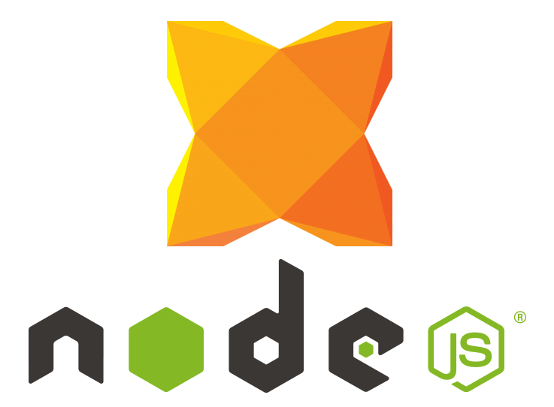
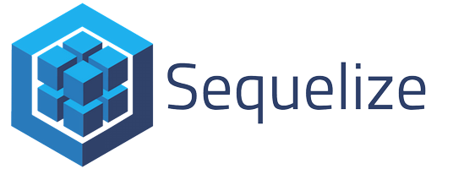

Implementation Details
Implemented a REST API
Simple web frontend for system testing
Technologies used
Node.js
Restify (server)
Sequelize (database)
Mocha (testing)
Notes:
Anirudh
Restify: talk about express, etc
Sequelize: ORM, promises, foreign keys
Mocha: many choices, hard to find integration, rollback

Slide 9
Use Case Demo
Notes:
Anirudh

